Slide 1

Wellcome
To
Ethical Hacking Class
4th Week
Day 1st

Slide 2
Vulnerability Assessment Fundamentals
Definition:
Vulnerability assessment is the process of identifying, quantifying, and prioritizing vulnerabilities in systems, applications, and networks. It aims to detect weaknesses that can be exploited by attackers and provides a roadmap for remediation.
Examples:
Network Vulnerability Assessment: An organization conducts a vulnerability assessment to identify open ports and outdated software on its servers, reducing the risk of unauthorized access.
Web Application Vulnerability Assessment: A company tests its online shopping platform to find common vulnerabilities like SQL injection and cross-site scripting (XSS).
Techniques and Tools:
Techniques:
- Asset Discovery
- Vulnerability Identification
- Risk Assessment
- Remediation and Mitigation
Tools/Websites:
- Nessus
- Qualys
- Rapid7 InsightVM

Slide 3


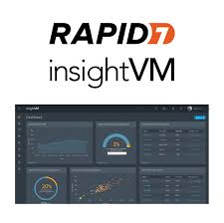
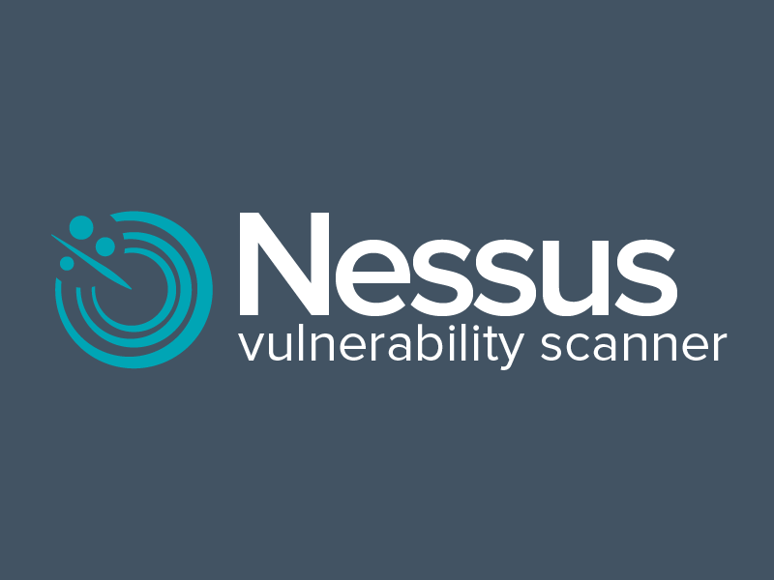
Vulnerability Assessment Fundamentals

Slide 4
Types of Vulnerabilities
Types of Network Scans
Definition:
Vulnerabilities can exist in software, hardware, or network configurations and may be exploited by malicious actors to gain unauthorized access or cause damage.
Examples:
Software Vulnerabilities: Bugs or flaws in software applications, such as buffer overflows or improper input validation, which attackers can exploit to execute arbitrary code.
Configuration Vulnerabilities: Incorrect security settings in software or network devices, like weak passwords or open ports, which can be leveraged by attackers to gain unauthorized access.
Techniques and Tools:
Techniques:
- Security Patch Management
- Configuration Management
- Code Review and Testing
Tools/Websites:
- OWASP Top Ten
- NIST National Vulnerability Database (NVD)
- CVE Details

Slide 5
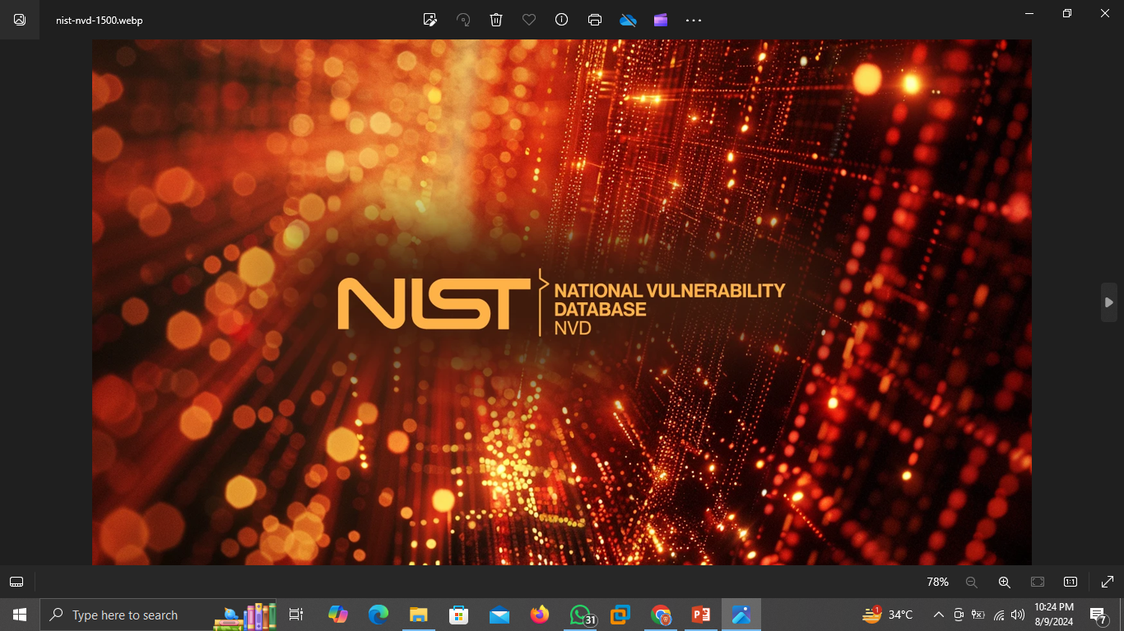
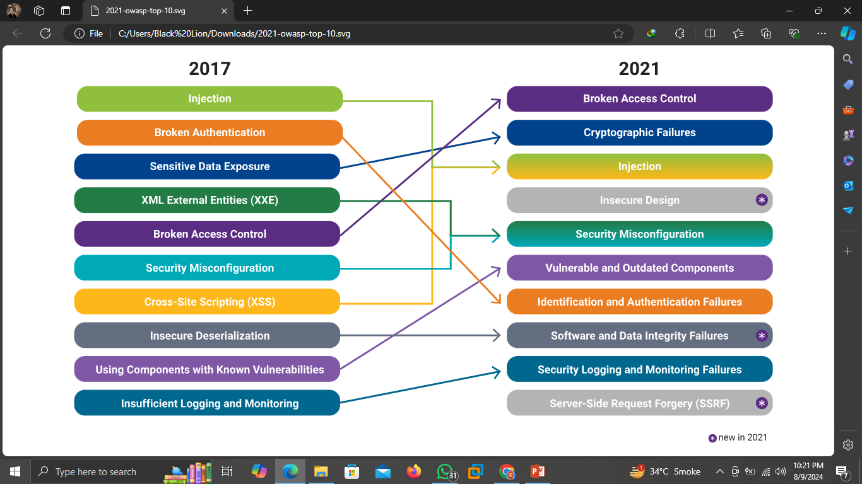

Types of Vulnerabilities

Slide 6
Vulnerability Scanning Techniques
Definition:
Vulnerability scanning involves using automated tools to inspect systems and networks for known vulnerabilities. This process helps identify security weaknesses without causing harm to the systems.
Examples:
Credentialed Scanning: A vulnerability scan performed with administrative access to the system, allowing deeper inspection and more accurate results
2. Non-Credentialed Scanning: A scan conducted without special access privileges, providing a view similar to that of an external attacker.
Techniques and Tools:
Techniques:
- Host-Based Scanning
- Network-Based Scanning
- Wireless Network Scanning
Tools/Websites:
- OpenVAS
- Nessus
- Nikto

Slide 7
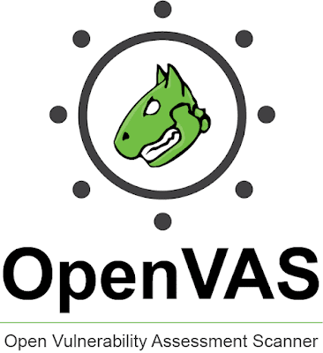


Network Scanning Fundamentals

Slide 8

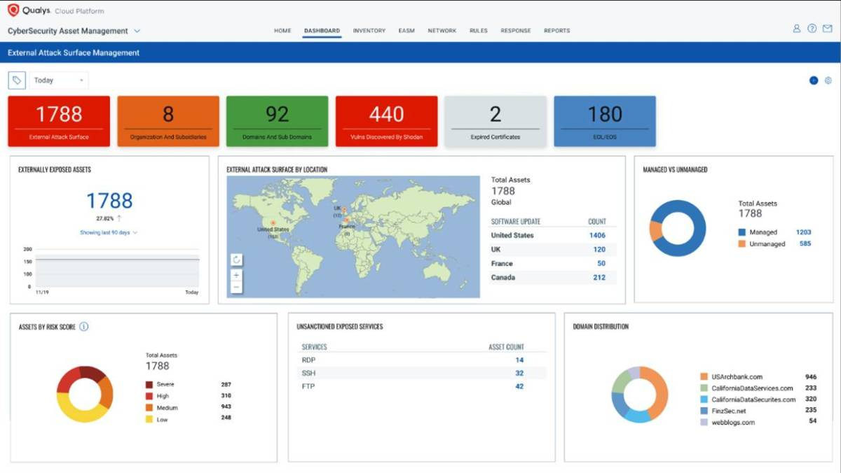
Automated Vulnerability Scanners
Definition:
Automated vulnerability scanners are tools that automatically detect vulnerabilities in systems, networks, and applications. These tools use predefined signatures to identify known security weaknesses.
Examples:
1. Nessus: A widely used vulnerability scanner that performs comprehensive scans to identify vulnerabilities, configuration issues, and compliance violations.
2. Qualys Vulnerability Management: A cloud-based service that continuously scans IT assets to detect vulnerabilities and track remediation.
Techniques and Tools:
- Signature-Based Scanning
- Behavioral Analysis
- Heuristic Analysis
Tools/Websites:
- Nessus
- Qualys
- Rapid7 InsightVM

Slide 9

Manual Vulnerability Assessment
Definition:
Manual vulnerability assessment involves human experts analyzing systems and applications to identify vulnerabilities, often using custom scripts and manual techniques. This approach complements automated scanning by identifying complex vulnerabilities.
Examples:
Penetration Testing: Security experts simulate attacks on a network to uncover vulnerabilities that automated tools might miss.
Code Review: Security analysts manually review source code to identify potential security weaknesses such as hardcoded credentials or insecure cryptographic practices.
Techniques and Tools:
- Manual Code Review
- Security Audits
- Threat Modeling
Tools/Websites:
- Burp Suite
- OWASP ZAP
- Metasploit (for penetration testing).

Slide 10
Most powerful Tools/Websites
01
Nessus
https://www.tenable.com/products/nessus
https://github.com/praveendhac/nessus-docker
02
Burp Suite
https://portswigger.net/burp
https://www.kali.org/tools/burpsuite/
03
Rapid7 InsightVM
https://www.rapid7.com/products/insightvm/
https://docs.rapid7.com/insightvm/insightvm-quick-start-guide/
04
Metasploit https://www.metasploit.com/
https://www.wireshark.org/docs/
https://github.com/rapid7/metasploit-framework

Slide 11
Thank You!
Happy Hacking

